Slide 1
Search

Slide 2
Solving problems by searching (1)
How can an agent look ahead to find a sequence of actions that will eventually achieve its goal?
In cases in which an agent needs to plan ahead to consider a sequence of actions that form a path to a goal state, such an agent is referred to as a problem-solving agent and the computational process is call search.
from Russell and Norvig

Slide 3
Solving problems by searching (2)
For now, we consider only the simplest environments:
Episodic
Single agent
Fully observable
Deterministic
Static
Discrete
Known
An algorithm is referred to as informed if the agent can estimate how far it is to the goal and uninformed if no such estimate is available.
from Russell and Norvig

Slide 4
Solving problems by searching (3)
If the agent has no additional information (i.e., the environment is unknown), then the agent can do no better than to execute one of the actions at random.
from Russell and Norvig

Slide 5
Problem-solving agents (1)
Given that the environment is known, the agent can follow a four-phase problem-solving process:
Goal formation. Goals organize behavior by limiting the objectives and, therefore, the actions to be considered.
Problem formulation. The agent devises a description of the states and actions necessary to reach the goal – an abstract model of the relevant part of the world.
Search. Before taking any action in the real world, the agent simulates sequences of actions in a model, searching until it finds a sequence of actions that reaches the goal. Such a sequence is called a solution.
Execution. The agent can now execute the actions in the solution, one at a time.
from Russell and Norvig

Slide 6
Problem-solving agents (2)
In any fully observable, deterministic, known environment, the solution to any problem is fixed sequence of actions.
If the model is correct, then once that agent has found a solution, it can ignore its percepts while it is executing that actions.
In control theory this is referred to as an open-loop system; ignoring the percepts breaks the loop between then agent and environment. If there a chance that the model is incorrect, or the environment is nondeterministic, then the agent would be better served using a closed-loop approach that monitors the percepts.
from Russell and Norvig

Slide 7
Search problems and solutions (1)
A search problem can be defined formally as follows:
A set of possible states in which the environment can be. This set is known as the state space.
A set of one or more goal states. If this set contains more than one state, “the goal” applies to any of the members of the set.
The actions available to the agent. Given a state s, Actions(s), returns a finite set of actions that can be executed in s. We say that each of these actions in applicable in s.
A transition model which describes the result of each action. Result(s,a) returns the state that results from applying action a in state s.
An action cost function, denoted by c(s,a,s’), that is the numeric cost of applying action a in state s to reach state s’.
from Russell and Norvig

Slide 8
Search problems and solutions (2)
A sequence of actions forms a path, and a solution is a path from the initial state to a goal state. We assume that actions costs are additive, i.e., the total cost of a path is the sum of the individual action costs.
An optimal solution is one that has the lowest path cost among all solutions.
The state space can be represented by a graph in which the vertices are states and the directed edges between them are actions.
from Russell and Norvig

Slide 9
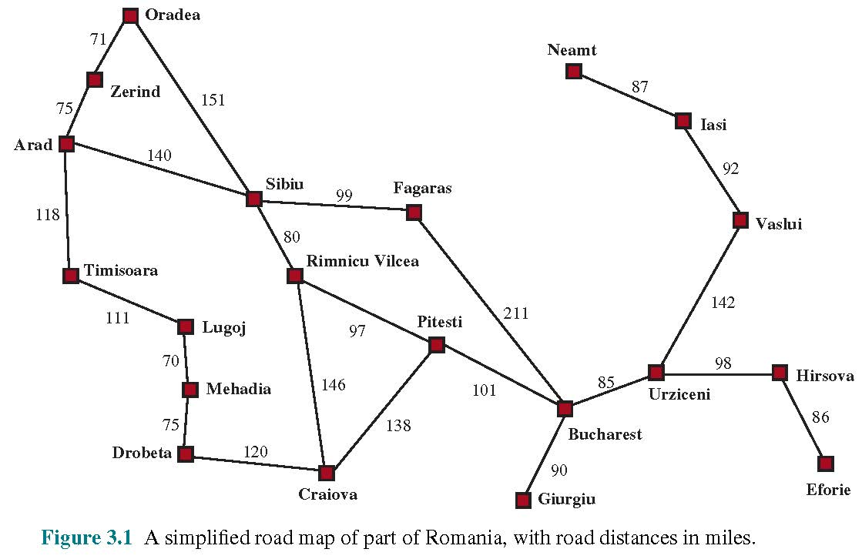
Graph for a road map example (3)
from Russell and Norvig

Slide 10
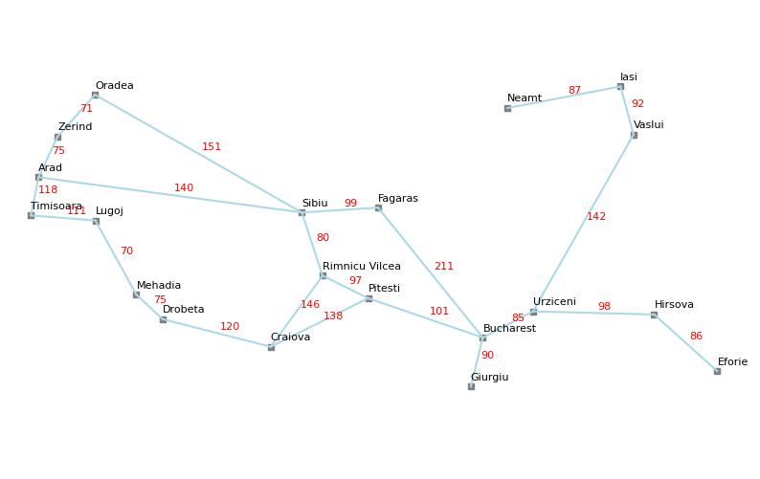
Graph for a road map example (4)

Slide 11
Example: Sliding-tile puzzle (1)
A sequence of actions forms a path, and a solution is a path from the initial state to a goal state. We assume that actions costs are additive, i.e., the total cost of a path is the sum of the individual action costs.
An optimal solution is one that has the lowest path cost among all solutions.
The state space can be represented by a graph in which the vertices are states and the directed edges between them are actions.
from Russell and Norvig

Slide 12
Example: Sliding-tile puzzle (2)
In a sliding-tile puzzle, a number of tiles are arranged in a (typically rectangular) grid with one or more black spaces so that some of the tiles can slide into a blank space.
The best know variants of these puzzles are the 8-puzzle which consists of a 3x3 grid with eight numbered tiles and one blank space and the 15-puzzle on a 4x4 grid.
The object is to reach a specified state, i.e. one with a specified ordering of the tiles.
from Russell and Norvig

Slide 13
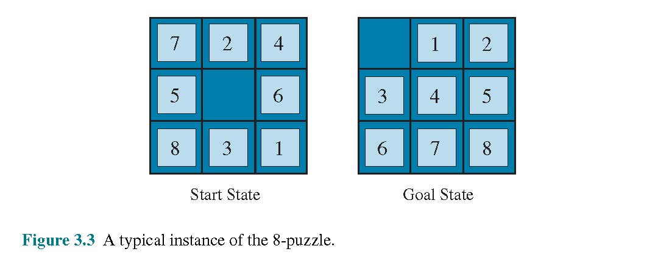
Example: Sliding-tile puzzle (3)
from Russell and Norvig

Slide 14
Example: Sliding-tile puzzle (4)
The standard formulation of the 8- or 15-puzzle is a follows:
States: A state description specifies the locations of each of the tiles.
Initial state: Any state can be designated as the initial state. A parity property partitions the state space – any given goal can be reached from exactly half of the possible initial states.
Actions: The simplest of an action is to think of the blank space moving Left, Right, Up, or Down. If the blank is at an edge or a corner, not all actions will be available.
Transition model: Such a model maps a state and an action to the resulting state.
Goal State: While any state could be the goal, it’s typically one in which the numbers of the tiles are in order.
Action cost: Each action costs 1.
from Russell and Norvig

Slide 15
Real-world search problems
Route-finding problems
GPS-based navigation systems
Routing of video streams in computer networks
Airline travel planning systems
Touring problems
Traveling salesperson problems
Routing of vehicles in a fleet
VLSI layout
cell layout
channel routings
Robot navigation
Automatic assembly sequencing of complex objects
Custom protein design
from Russell and Norvig

Slide 16
Search algorithms (1)
A search algorithm takes a search problem as input and returns a solution or an indication of failure.
In this section we consider algorithms that superimpose a search tree over that state-space graph. Each node in the search tree corresponds to a state in the state space and the edges in the search tree correspond to actions. The root of the tree corresponds to the initial state of the problem.
from Russell and Norvig

Slide 17
Search algorithms (2)
The distinction between that state space and the search tree is important.
The state space describes the (possible infinite) set of states in the world, and the actions that allow transitions from one state to another.
The search tree describes paths between these states reaching toward the goal. The search tree may have multiple paths to (and thus multiple nodes for) any given state, but each node in the tree has a unique path back to the root.
from Russell and Norvig

Slide 18
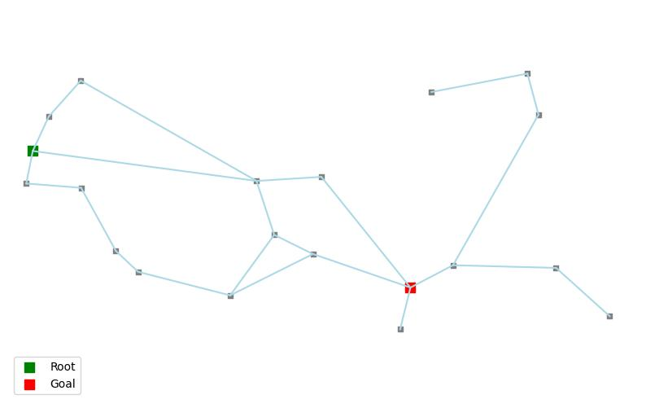
Search algorithms (3)

Slide 19
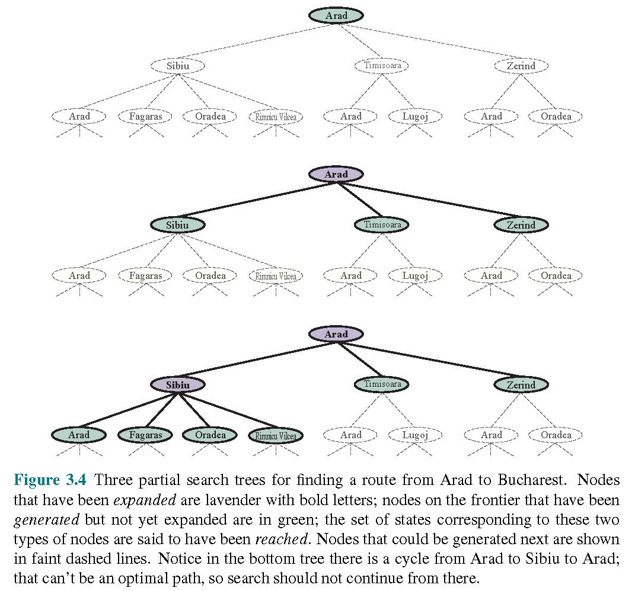
Search algorithms (4)

Slide 20
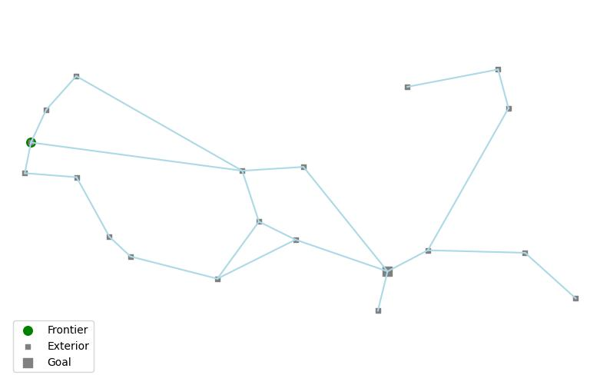
Search algorithms (5)

Slide 21
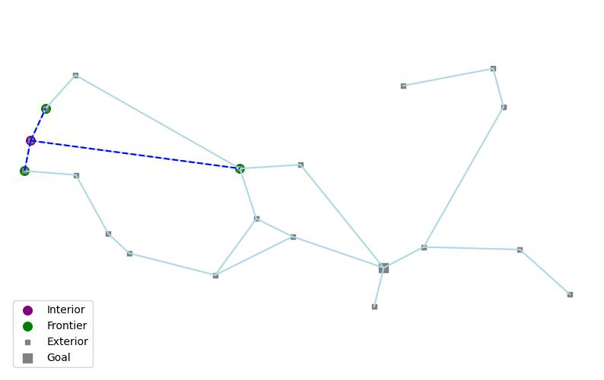
Search algorithms (6)

Slide 22
Search algorithms (7)

Slide 23
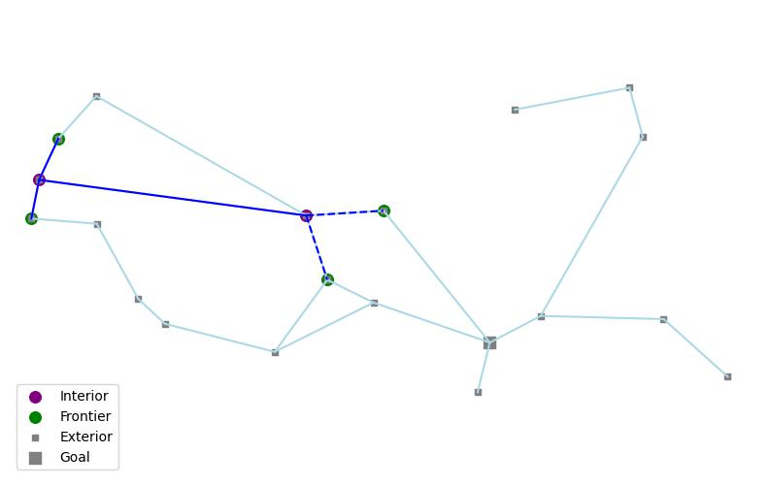
Search algorithms (8)

Slide 24
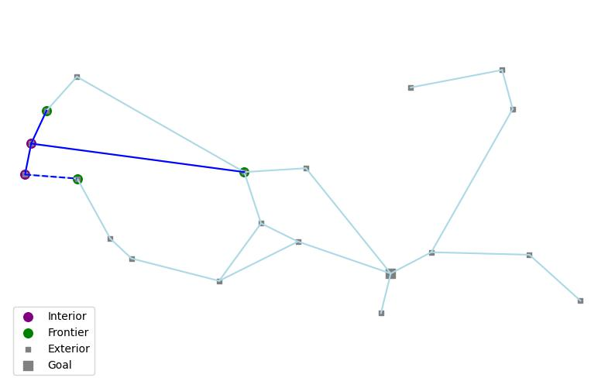
Search algorithms (9)

Slide 25
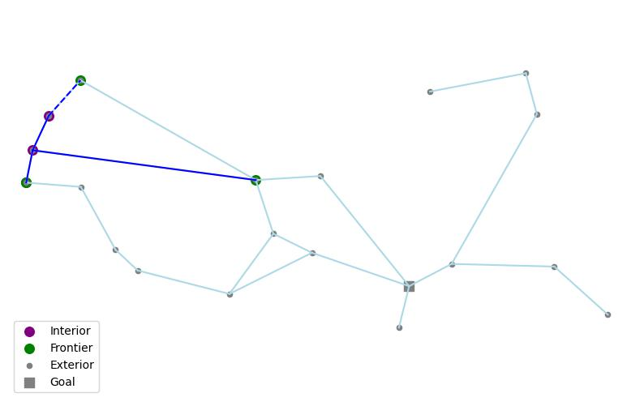
Search algorithms (10)

Slide 26
Frontiers (1)
We can expand the first node by considering the available actions for that state. These actions lead to and generate a new node for each of the resulting states. The new node is called a child node or successor node.
We now choose which of the child nodes to consider next, while holding the other(s) aside for later.
This choice the is essence of search.
from Russell and Norvig

Slide 27
Frontiers (2)
Depending on where we are in the process, states have been reached or not. We referred to them as either being reached or unreached.
The states are reached but are adjacent to one or more unreached states are referred to as frontier states. The frontier states are said to form the frontier of the state-space graph.
The frontier separates two regions of the state-space graph: an interior region in which every state has been expended and an exterior region in which every state has not yet been reached. The frontier separates the interior and exterior regions.
from Russell and Norvig

Slide 28
Best-first search
How do we decide which node from the frontier to expand next? A very general approach is called best-first search in which we choose a node, n, with minimum value of some evaluation function, f(n).
On each iteration we choose a node on the frontier with minimum f(n) value, return if its state is a goal state, and otherwise expand to generate child nodes. Each child node is added to the frontier if it has not been reached before, or is re-added, if it is not being reached with a path that has a lower path cost than any previous path. The algorithm returns either an indication of failure, or a node that represents a path to a goal. Different evaluation functions lead to different specific search algorithms.
from Russell and Norvig

Slide 29
Search data structures (1)
Search algorithms require a data structure to keep track of the search tree. A node in the tree is represented by a data structure with four components:
node.STATE – the state to which the node corresponds,
node.PARENT – the node in the tree that generated this node,
node.ACTION – that action applied at the parent node that generated this node,
node.PATH-COST – total cost of the path from the initial state to this node. g(node) is used as a synonym for PATH-COST.
from Russell and Norvig

Slide 30
Search data structures (2)
Following the PARENT pointers back from a node allows us to recover the states and actions along the path to that nodes.
Doing so from a goal node gives us a solution.
from Russell and Norvig

Slide 31
Search data structures (3)
We need a data structure to store the frontier. The appropriate choice is a queue of some kind. The operations on a frontier are:
IS-EMPTY(frontier) returns true only if there are no nodes in the frontier.
POP(frontier) removes the top node from the frontier and returns it.
TOP(frontier) returns (but does not remove) the top node of the frontier.
ADD(node,frontier) inserts a node into its proper place in the queue.
from Russell and Norvig

Slide 32
Search data structures (4)
Three kinds of queues are used in search algorithms.
A priority queue first pops the node with the minimum cost according to some evaluation function f. It is used in best-first search.
A FIFO queue, or first-in-first-out queue first pops the node that was added to the queue first. It is used in breadth-first search.
A LIFO queue or last-in-first-out queue (a.k.a. a stack) pops first the most recently added node. It is used in depth-first search.
from Russell and Norvig

Slide 33
Redundant paths
Often, there are multiple paths from the root node to the goal. We refer to the paths that are longer than the shortest path to be redundant paths.
A special case of a redundant path is a cycle (a.k.a. a loopy path). A cycle is a path in which a node is visited more than once. If a node can be visited twice, it can be visited any number of times.
A search algorithm is referred to as a graph search if it checks for redundant paths and a tree-like search if it does not check.
The best-first-search algorithm is a graph-search algorithm.
from Russell and Norvig

Slide 34
Measuring problem-solving performance
Comparing the performance of different search algorithms requires criteria by which to measure them.
The performance of an algorithm can be measured in four ways:
Completeness – Is the algorithm guaranteed to find a solution if there is one and to correctly report failure when there is not?
Cost optimality – Does it find a solution with the lowest path cost of all solutions?
Time complexity – How long does it take to find a solution? Time can be measured in seconds or, more abstractly, by the number of states and actions considered.
Space complexity – How much memory is needed to perform the search?
from Russell and Norvig

Slide 35
Uninformed search strategies
A search algorithm is said to be uninformed if it is given no clue as to how close a state is to the goal(s) and informed is it is.
In the Romanian journey example, an uninformed search would have no knowledge of Romanian geography, while an informed one would know the geographic location of each city.
from Russell and Norvig

Slide 36
Breadth-first search (1)
When all actions have the same cost, an appropriate strategy is breadth-first search, in which the root node is expanded first, then all the successors of the root node are expanded, and then their successors, and so on.
This is a systematic search strategy that is therefore complete even on infinite state spaces.
Breadth-first search always finds a solution with a minimal number of actions because when it is generating nodes of depth d it has already generated all the node at depth d-1, so if one of them were a solution, it would already have been found.
from Russell and Norvig

Slide 37
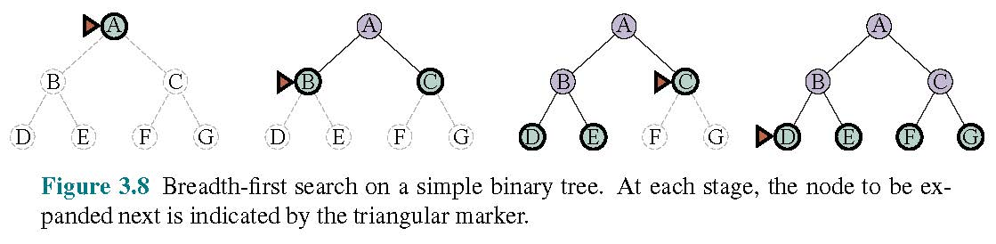
Breadth-first search (2)
from Russell and Norvig

Slide 38
Breadth-first search (3)
Breadth-first search is cost-optimal for problems where all actions have the same cost, but not for problems without this property.
If we had a uniform tree where every state had b successors and the solution is at depth d, then the total number of nodes generated would be
1+b+b²+b³+…+b^{d} = O(b^{d}).
Since all the nodes remain in memory, both time and space complexity are O(b^{d}). In general, such exponential-complexity search problems cannot be solved by uninformed search for any but the smallest instances.
from Russell and Norvig

Slide 39
Dijkstra’s algorithm (uniform cost search)
When actions have different costs, an obvious choice is to use best-first search where the evaluation function is the cost of the path from the root to the current node. This is referred to as Dijkstra’s algorithm or uniform-cost search.
Breadth-first search spreads out in waves of uniform depth (i.e., depth 1, depth 2, …), while uniform-cost search spreads out in waves of uniform path-cost.
from Russell and Norvig

Slide 40
Depth-first search (1)
Depth-first search always expands the deepest node in the frontier first.
Depth-first search first proceeds to the deepest level of the search tree, where the nodes have no successors. It then “backs up” to the next deepest node that still has unexpanded successors.
from Russell and Norvig

Slide 41
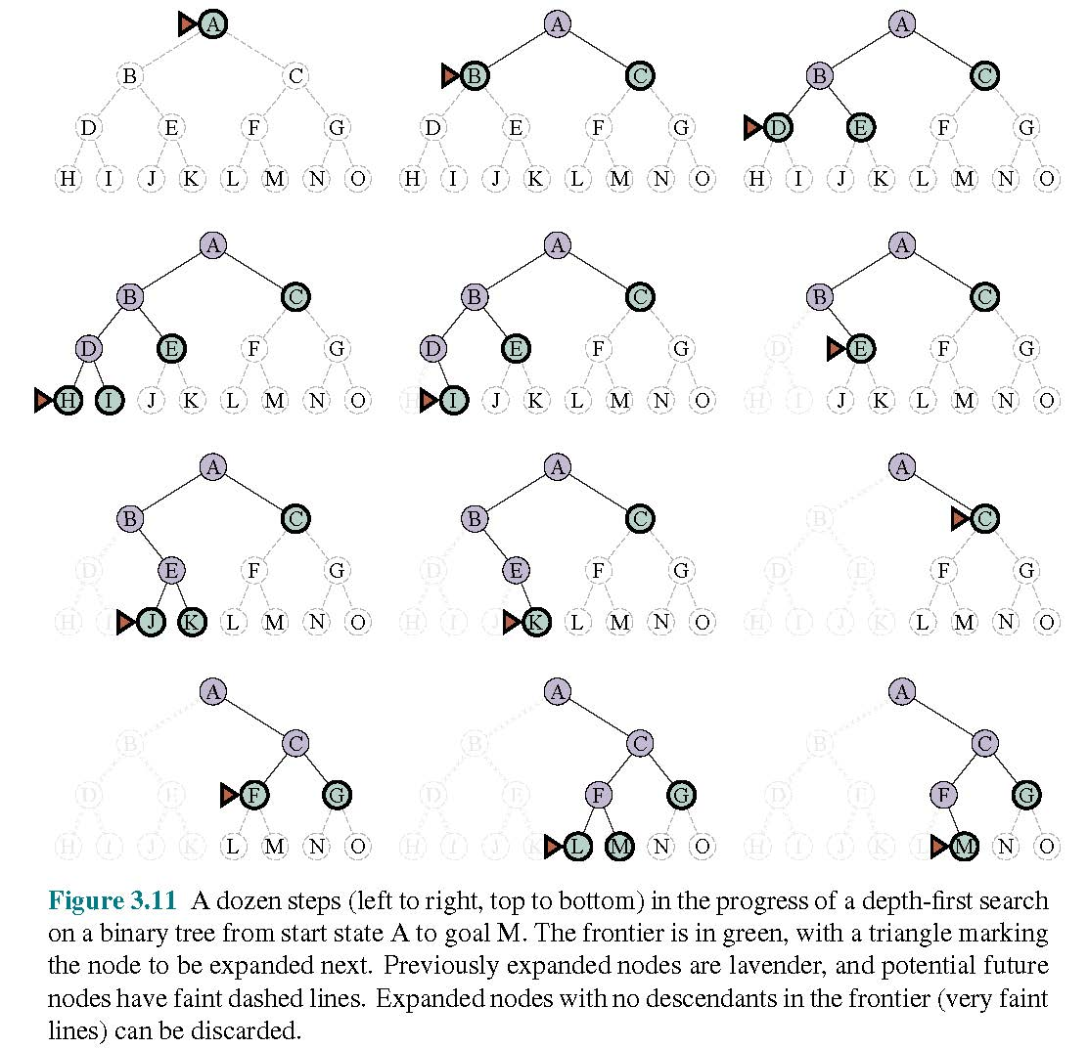
Depth-first search (2)
from Russell and Norvig

Slide 42
Depth-first search (3)
Depth-first search is not cost optimal; it returns the first solution it finds, even if it is not the cheapest.
For finite state spaces that are trees it is efficient and complete; for acyclic state spaces it may end up expanding the same state many times via different paths but will eventually explore the entire space.
In cyclic state spaces it can get stuck in an infinite loop. In infinite state spaces, depth-first search is not systematic; it can get stuck going down an infinite path, even if there are no cycles. Thus, depth-first search is incomplete.
from Russell and Norvig

Slide 43
Depth-first search (4)
An advantage of depth-first search is for problems in which a tree-like search is feasible, depth-first search requires much less memory that breadth-first search.
A variant of depth-first search called backtracking search uses even less memory. In backtracking, only one successor is generated at a time rather than all successors at once. Each partially expanded node remembers which successor to generate next. In addition, successors are generated by modifying the current state description directly rather than allocating memory for a brand-new state.
For backtracking, we must be able to undo each action when we backtrack.
from Russell and Norvig

Slide 44
Depth-limited & iterative deepening search (1)
To keep depth-first search from wandering down an infinite path, we can use depth-limited search, a version of depth-first search in which we provide a depth limit, l, and treat all nodes at depth l as if they has no successor nodes. For this approach, the time complexity is O(b^{l}) and the space complexity is O(bl).
Unfortunately, if the chosen value of l is too small, the algorithm will fail to reach the solution, making it incomplete.
The number of actions with which any node can be reached from any other node is known as the diameter of the state-space graph. This measure typically provides a better depth limit than the simpler depth limit l.
from Russell and Norvig

Slide 45
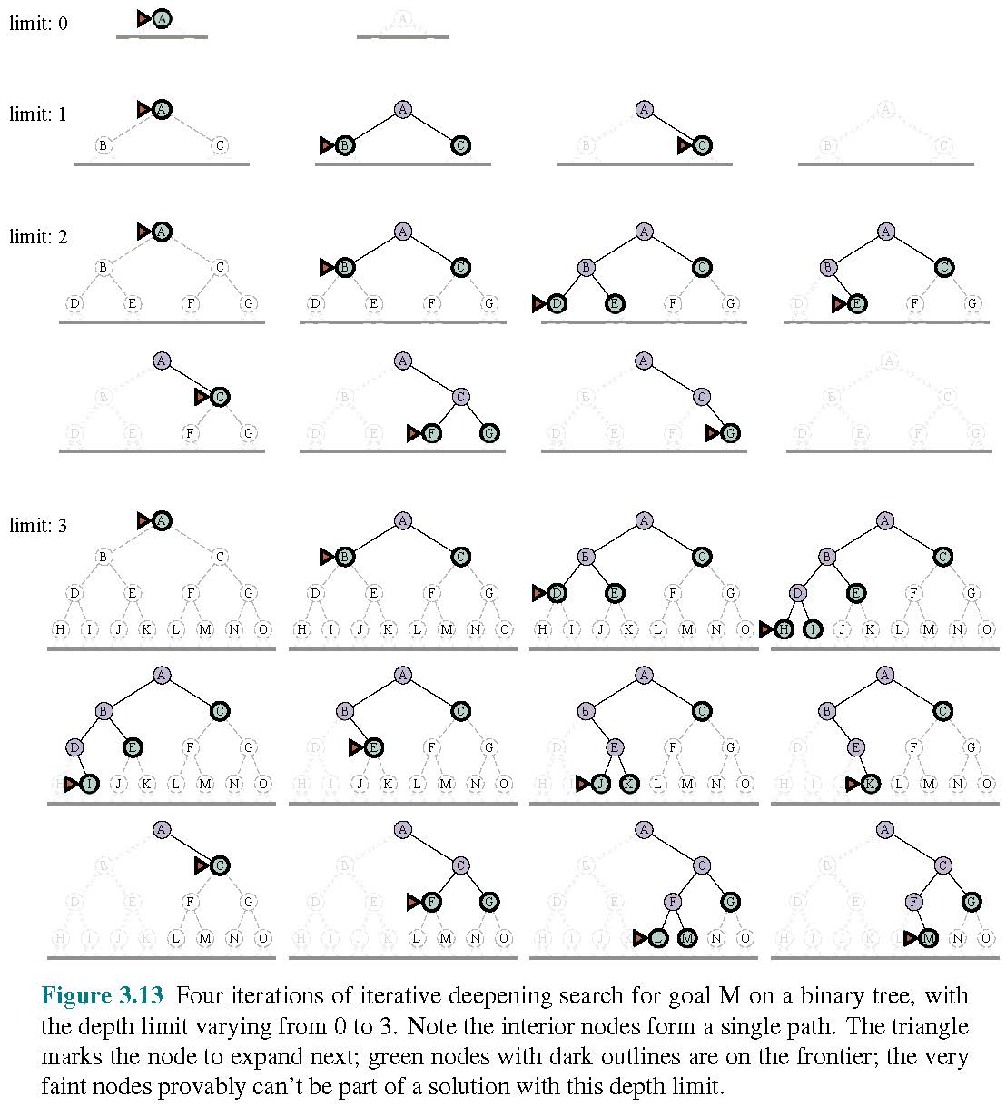
Depth-limited and iterative deepening search (2)
from Russell and Norvig

Slide 46
Bidirectional search
An alterative approach to search, call bidirectional search, searches both forward from the initial node and backward from the goal state.
The motivation for this is that typically,
Bidirectional search requires that we keep track of two frontiers and two tables of reached states and we need to be able to reason backwards: if state s’ is a successor of s in the forward direction and s is a successor of s’ in the backward direction, then we have a solution where the two frontiers collide.
There are many variants of directional search.
from Russell and Norvig

Slide 47
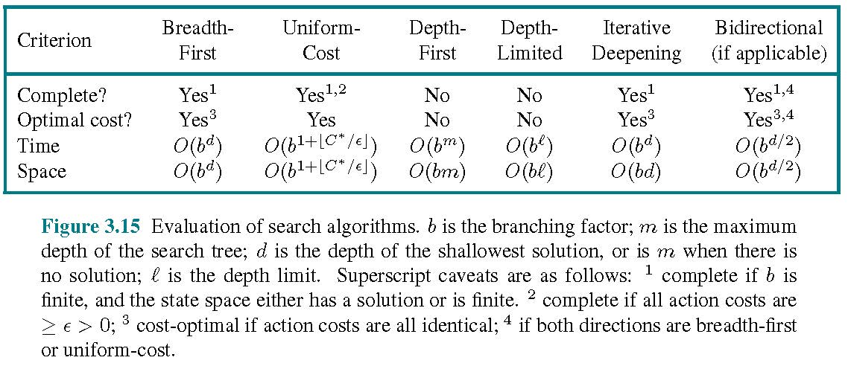
Comparing uninformed search algorithms
C* is the cost of the optimal path
from Russell and Norvig

Slide 48
Informed (heuristic) search strategies (1)
Sometimes, searches can be made more efficient by using domain-specific hints about the location of goals. The hints come in the form of a heuristic function, denoted by h(n).
h(n) = estimated cost of the cheapest path from that state at node n to a goal state.
For example, in route-finding problems, we can estimate the distance from the current state to a goal by computing the straight-line distance on a map between the two points.
from Russell and Norvig

Slide 49
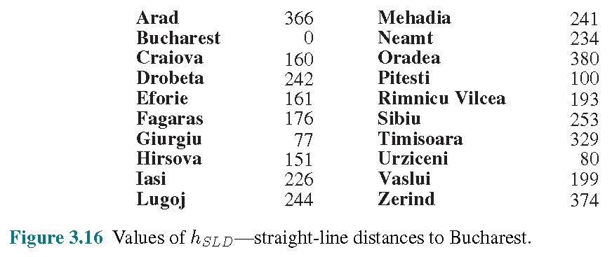
Informed (heuristic) search strategies (2)
from Russell and Norvig

Slide 50
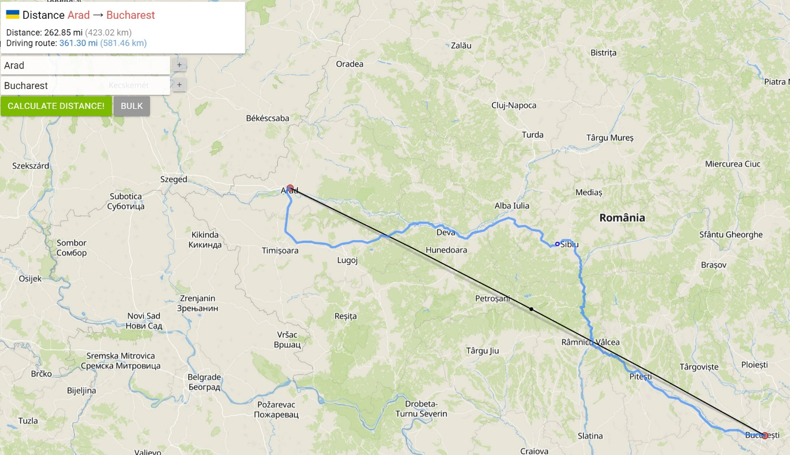
Informed (heuristic) search strategies (3)
from Russell and Norvig

Slide 51
Greedy best-first search
Greedy best-first search is a form of best-first search that expands first the node with the lowest h(n) value – the node that appears to be closest to the goal – on the assumption that this is likely to lead to a solution quickly.
So, the evaluation function f(n)=h(n).
from Russell and Norvig

Slide 52
A* search (1)
The most common informed search algorithm is A* search (pronounced “A-star search”), a best-first search the uses the evaluation function
f(n)=g(n)+h(n)
where g(n) is the path cost from the initial state to node n, and h(n) is the estimated cost of the shortest path from n to a goal state, so we have
f(n)= estimated cost of the best path that continues from n to a goal.
from Russell and Norvig

Slide 53
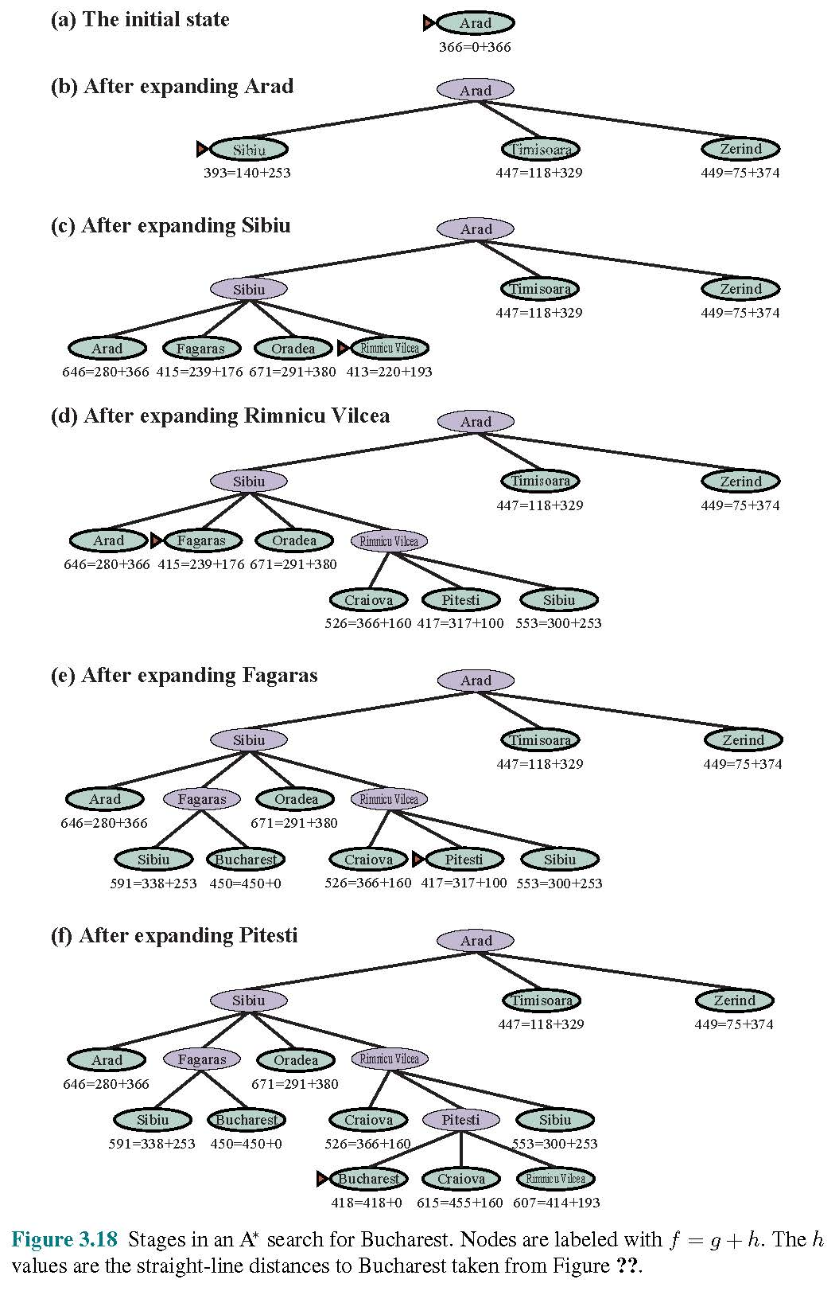
A* search (2)
from Russell and Norvig

Slide 54
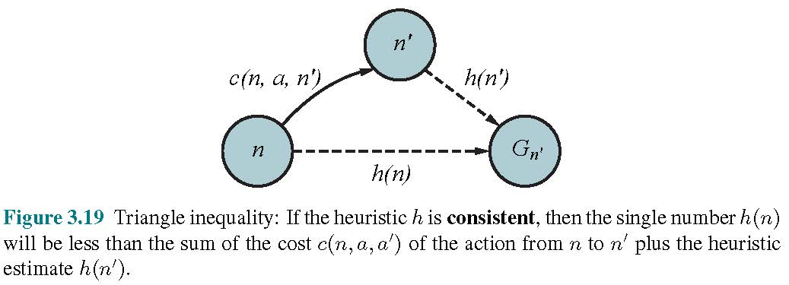
A* search (3)
A* is complete. Whether A* is cost-optimal depends on certain properties of the heuristic. A key property is admissibility: an admissible heuristic is one that never overestimates the cost to reach a goal. As such, it is therefore optimistic.
With an admissible heuristic, A* is cost-optimal.
from Russell and Norvig

Slide 55
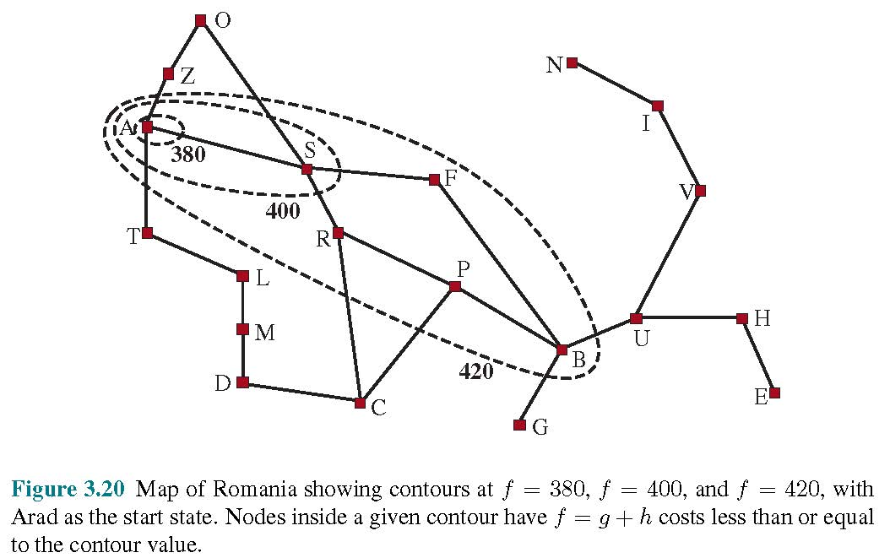
Search contours (1)
A way to visualize a search is to draw contours in the state space, just like the contours on a topographic map.
For example, inside the contour labeled 400, all nodes have
f(n)=g(n)+h(n) ≤ 400. A* expands the frontier node of lowest f-cost and an A* search fans out from the start node, adding nodes in concentric bands of increasing f-cost.
from Russell and Norvig

Slide 56
Search contours (2)
With uniform-cost search we have contours but of g-cost, not g+h. The contours of uniform cost search will be “circular” around the start state, spreading out equally in all directions with no preference towards the goal.
With A* search using a good heuristic, the g+h bands will stretch toward a goal state and become more narrowly focused around an optimal path.
If you extend a path, the g costs are monotonic since the action costs are always positive.
from Russell and Norvig

Slide 57
Search contours (3)
It is not obvious whether the f=g+h cost will monotonically increase. As the path is extended from n to n’, the cost goes from g(n)+h(n) to g(n)+c(n,a,n’)+h(n’). Cancelling out the g(n), it follows that the path’s cost will be monotonically increasing if and only if h(n) ≤ c(n,a,n’)+h(n’), i.e., if and only if the heuristic in consistent.
from Russell and Norvig

Slide 58
Search contours (4)
If C* is the cost of the optimal solution path, then
A* expands all nodes that can be reached from the initial state on a path where every node on the path has f(n)=C*. We call these surely expanded nodes.
A* might then expand some of the nodes right on the “goal contour” (where f(n)=C*) before selecting a goal node.
A* expands no nodes with f(n) > C*.
We say that A* with a consistent heuristic is optimally efficient in the sense that any algorithm that extends search path from the inital state, and uses the same heuristic information, must expand all nodes that are surely expanded by A*.
from Russell and Norvig

Slide 59
Search contours (5)
A* is efficient because it prunes away search tree nodes that are not necessary for finding an optimal solution.
A* search is complete, cost-optimal, and optimally efficient among all such algorithms.
However, for many problems the number of nodes expanded in an A* search can be exponential in the length of the solution, making the approach infeasible.
from Russell and Norvig

Slide 60
Satisficing search
We can explore fewer nodes that would be explored in an A* search if we are willing to accept solutions that are suboptimal but “good enough.” We call such suboptimal solutions satisficing solutions.
If we allow A* search to use in inadmissible heuristic – one that can overestimate – then we risk missing the optimal solution.
from Russell and Norvig

Slide 61
Search results hierarchy
All optimal solutions
Some optimal solutions
Satisficing solutions
“Not good enough” solutions

Slide 62
Other topics in search
The list is too long to include here!

